Slide 1

Explore Relational Data in Azure
Week 8 - Lab 4 Preparation & Guidelines
Dr Farshid Keivanian

Slide 2
Week 8 – Lab 4
This PowerPoint is an optional guide to help you implement the steps from the official Week 8 – Lab 4 document. You must still follow the exact instruction and requirements as outlined in the official Canvas instructions and rubric.

Slide 3
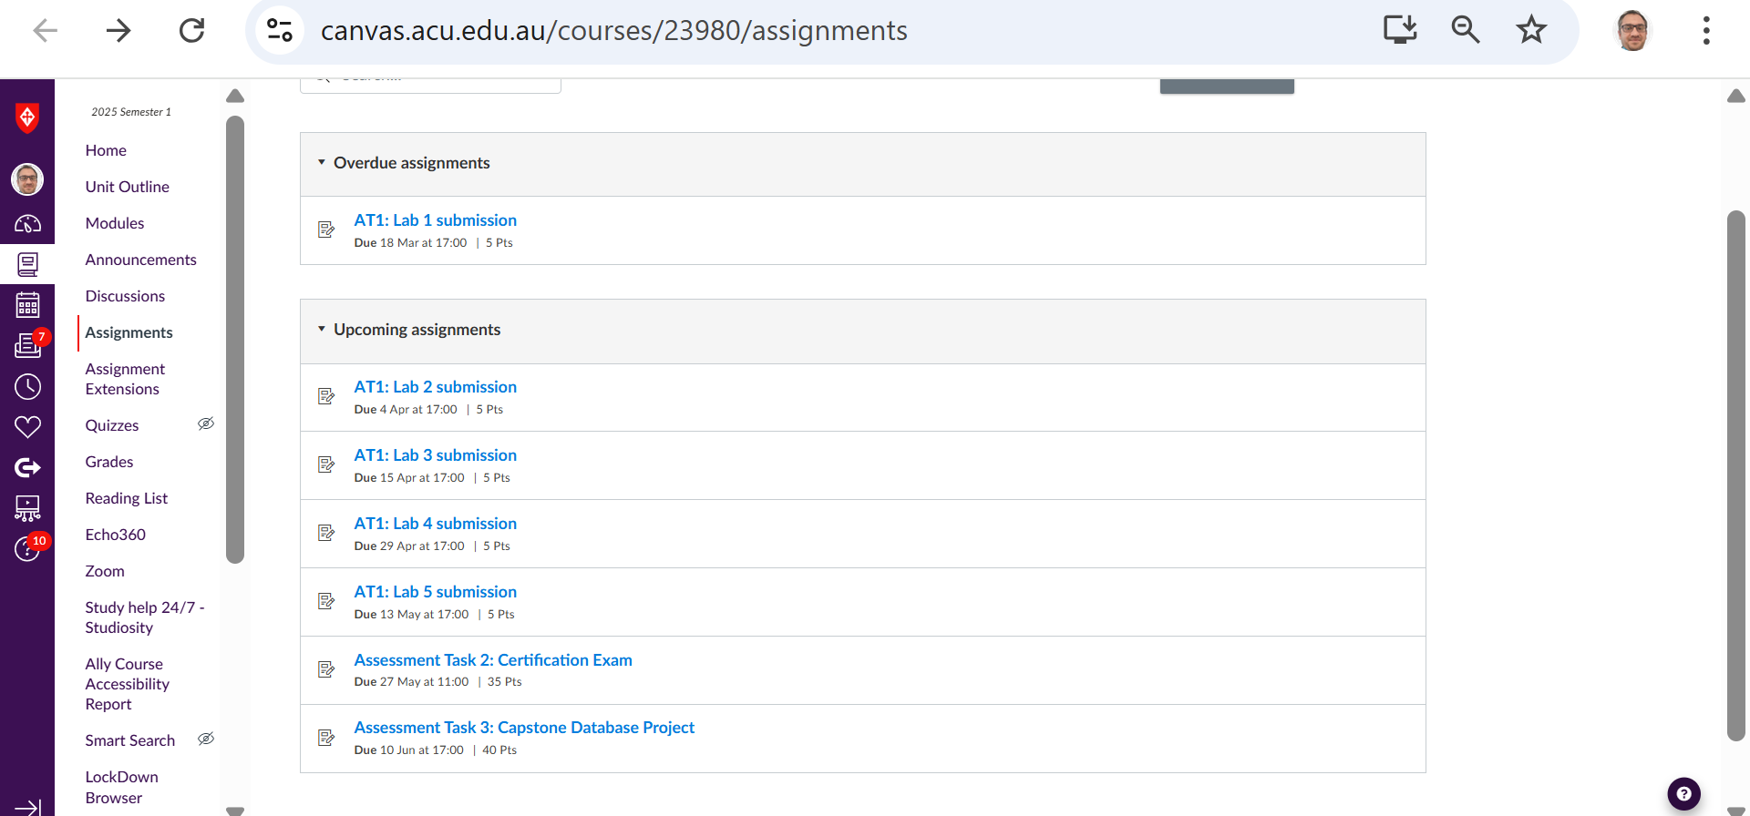
Week 8 – Lab 4
Navigate Canvas >> Modules >> Week 8: Lab 4
2 | Faculty of Business and Law | Peter Faber Business School

Slide 4
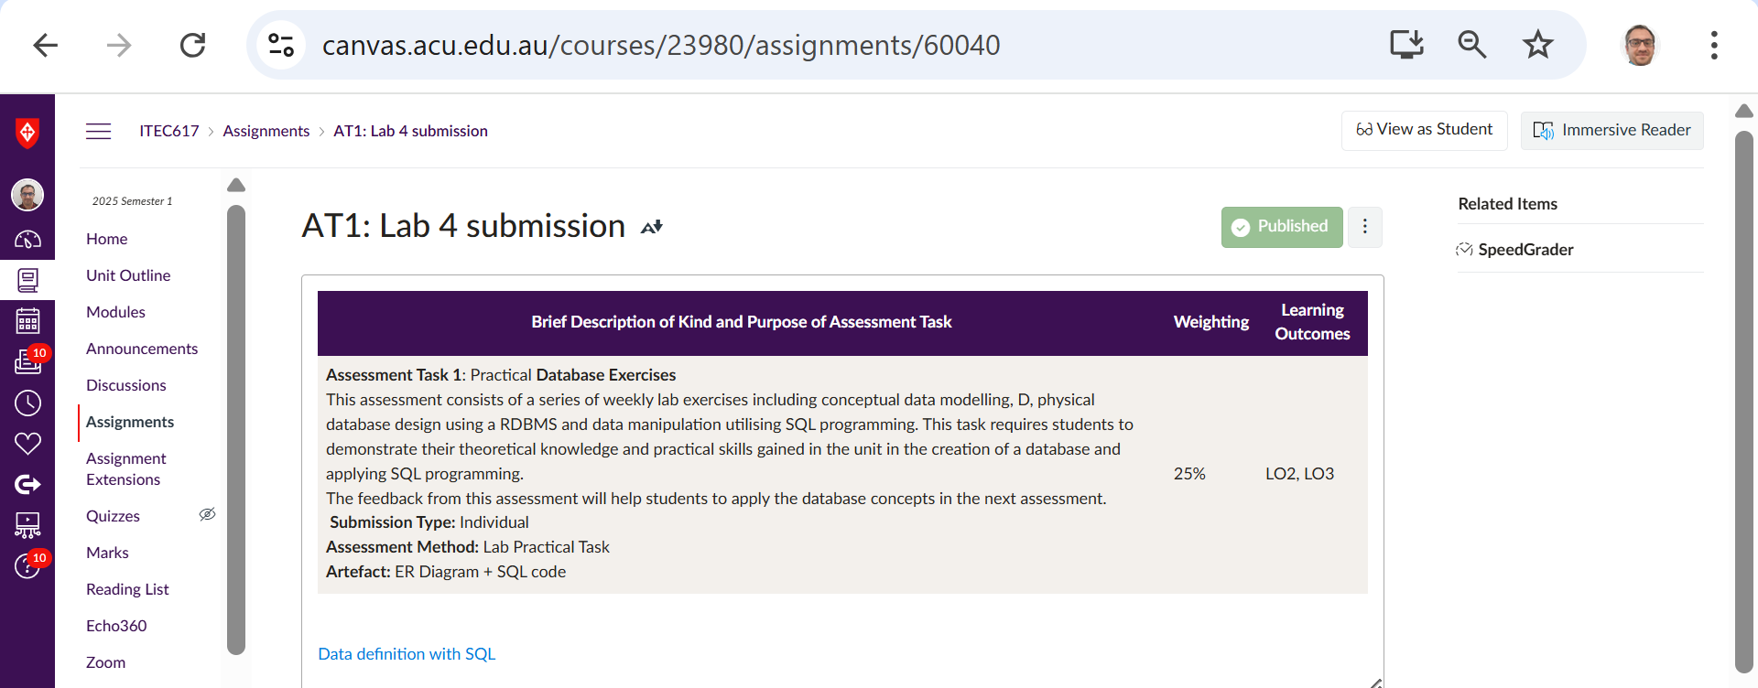
Week 8 – Lab 4
Navigate Canvas >> Modules >> Week 8: Lab 4
2 | Faculty of Business and Law | Peter Faber Business School

Slide 5
Week 8 – Lab 4
Breakdown of Lab Types:
Lab Session | Topic | Lab Type | Saving Enabled? | Notes
Lab 1 & 2 | Setup + SQL Basics | Normal Lab (Skillable) | Yes | SQL practice, MySQL setup
Lab 3 | Explore relational data in Azure | Cloud Slice | X No | Must be done in one sitting (up to 10 launches)
2 | Faculty of Business and Law | Peter Faber Business School

Slide 6
Week 8 – Lab 4
Breakdown of Lab Types:
Lab Session | Topic | Lab Type | Saving Enabled? | Notes
Lab 4 | Data Definition with SQL (MySQL) | Normal Lab | Yes | On your own PC using MySQL Workbench
Lab 5 | Explore non-relational data in Azure | Cloud Slice | X No | Azure virtual lab – 10 launches only
2 | Faculty of Business and Law | Peter Faber Business School

Slide 7
Week 8 – Lab 4
Breakdown of Lab Types:
Lab Session | Topic | Lab Type | Saving Enabled? | Notes
Lab 6 | DP-900 Practice Test | Cloud Slice | X No | Practice exam must be done in one sitting
2 | Faculty of Business and Law | Peter Faber Business School

Slide 8
Goals of this Lab
The main goals of this lab are to help you:
Create a database based on the theoretical concepts of data modeling.
Apply SQL programming to perform various data manipulation tasks.
Design an ER diagram (Entity-Relationship Diagram) to visually represent your database structure.
Demonstrate your ability to perform database operations like data definition, manipulation, and querying using SQL.
2 | Faculty of Business and Law | Peter Faber Business School

Slide 9
Can Students Only Use MySQL Workbench?
Yes, MySQL Workbench is the recommended tool for this lab, as it allows you to:
Create and manage databases.
Write and execute SQL queries.
Visualize the ER diagram.
However, if you are familiar with other MySQL-compatible tools, such as phpMyAdmin or DBeaver, you can use them, but you must still follow the guidelines and requirements of the assessment using SQL.
2 | Faculty of Business and Law | Peter Faber Business School

Slide 10
Theoretical Background for This Lab
This lab aims to apply your knowledge of:
Relational Database Management Systems (RDBMS): Using MySQL as the RDBMS for database creation, manipulation, and querying.
SQL Programming: Writing SQL code for creating tables, inserting data, updating, and querying databases.
Data Modeling: Understanding how to create an ER diagram and translate that into a database schema.
Normalization: Organizing your database to eliminate redundancy and ensure data integrity.
2 | Faculty of Business and Law | Peter Faber Business School

Slide 11
Skills Developed by Completing This Lab
By completing this lab, you will develop the following skills:
Database design using ER diagrams.
SQL coding skills for database creation, querying, and manipulation.
Understanding how to structure a database in a way that ensures efficiency and integrity.
Problem-solving skills related to SQL queries and database operations.
2 | Faculty of Business and Law | Peter Faber Business School

Slide 12
Submission Checklist
To submit the lab, ensure you have the following:
ER Diagram: A clear, well-labeled ER diagram based on the database schema.
SQL Code: All SQL queries you wrote to create and manipulate the database (including creating tables, inserting data, and running queries).
Screenshots: A screenshot of each query executed in MySQL Workbench, showing the query and the results. These screenshots should be pasted in a Word document.
2 | Faculty of Business and Law | Peter Faber Business School

Slide 13
Document to Submit for This Lab
Word Document (required): This document should contain the following:
Your ER diagram (you can either paste an image of the ER diagram or export it from MySQL Workbench).
SQL code used for creating the database and performing the exercises.
Screenshots of the SQL queries and their results.
2 | Faculty of Business and Law | Peter Faber Business School

Slide 14
Document to Submit for This Lab
SQL Code (required): Your SQL queries should be listed clearly in the Word document.
Screenshot (required): Take a screenshot for each SQL query and its output (result set) from MySQL Workbench. These screenshots should be inserted into the Word document.
2 | Faculty of Business and Law | Peter Faber Business School

Slide 15
What to Avoid?
Avoid copying code directly from the lab manual without understanding it. The goal is for you to apply and demonstrate your knowledge.
Avoid submitting incomplete work. Ensure that all tasks are completed, and queries executed.
2 | Faculty of Business and Law | Peter Faber Business School

Slide 16
What to Do?
Follow the lab manual instructions step by step. Complete each task thoroughly.
Take screenshots after each SQL query to show results.
Ensure your SQL code is well-organized and readable.
2 | Faculty of Business and Law | Peter Faber Business School

Slide 17
Summary of Learning Outcomes
By completing this lab, you will:
Develop a strong understanding of SQL and how to interact with a relational database.
Learn to create and manage a database using SQL and MySQL Workbench.
Be able to design a logical database schema through an ER diagram.
Gain hands-on experience in performing common database tasks such as querying, updating, and inserting data.
2 | Faculty of Business and Law | Peter Faber Business School

Slide 18
How to Download the Sakila Database
Follow these steps to download and set up the Sakila database in MySQL Workbench:
Download the Sakila Database:
Go to the MySQL Example Databases page.
Find the Sakila Database and download the file in either TGZ or ZIP format.
2 | Faculty of Business and Law | Peter Faber Business School

Slide 19
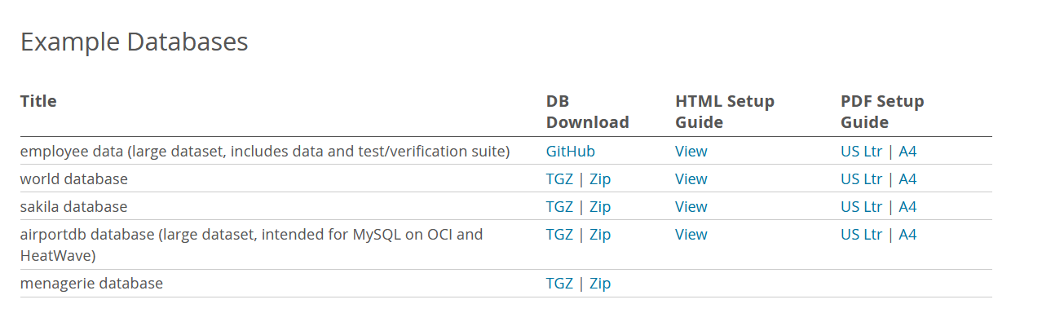
Extract the Files
Extract the Files:
After downloading the file, extract it to your preferred location.
The extraction should reveal two SQL scripts:
sakila-schema.sql (for creating the schema).
sakila-data.sql (for inserting sample data).
2 | Faculty of Business and Law | Peter Faber Business School

Slide 20
Extract the Files
Download sakila database DB Download (Zip); 712 Kb
This will download the Sakila database in a ZIP file format. After downloading, we can extract the files and proceed with setting up the database in MySQL Workbench.
2 | Faculty of Business and Law | Peter Faber Business School

Slide 21
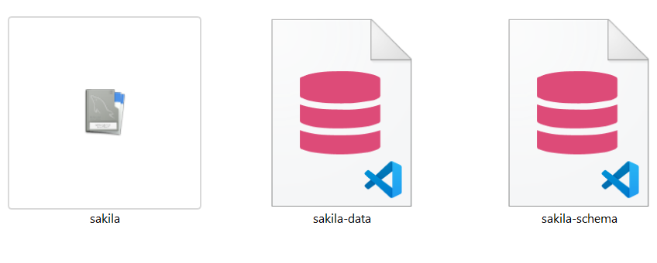
Downloaded Files
2 | Faculty of Business and Law | Peter Faber Business School

Slide 22
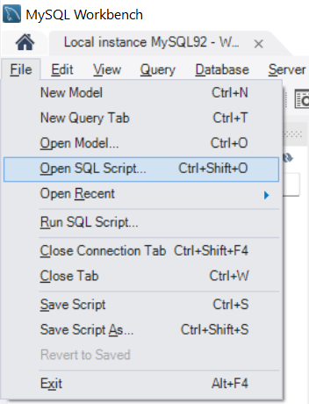
Navigate the SQL Script File
Open MySQL Workbench:
Launch MySQL Workbench on your system.
Open the SQL Script Files:
In MySQL Workbench, go to File > Open SQL Script.
Navigate to the folder where you extracted the Sakila database files.
Open the sakila-schema.sql file first.
2 | Faculty of Business and Law | Peter Faber Business School

Slide 23
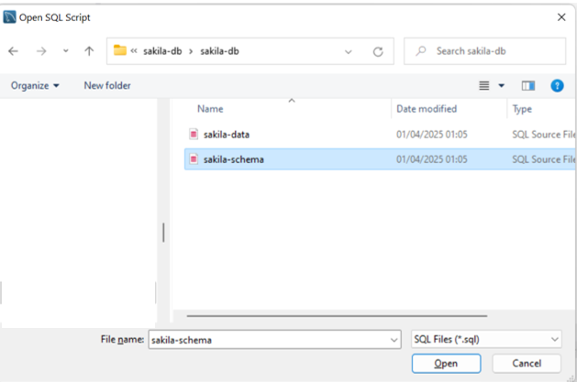
Navigate the SQL Script File
Open MySQL Workbench:
Launch MySQL Workbench on your system.
Open the SQL Script Files:
In MySQL Workbench, go to File > Open SQL Script.
Navigate to the folder where you extracted the Sakila database files.
Open the sakila-schema.sql file first.
2 | Faculty of Business and Law | Peter Faber Business School

Slide 24
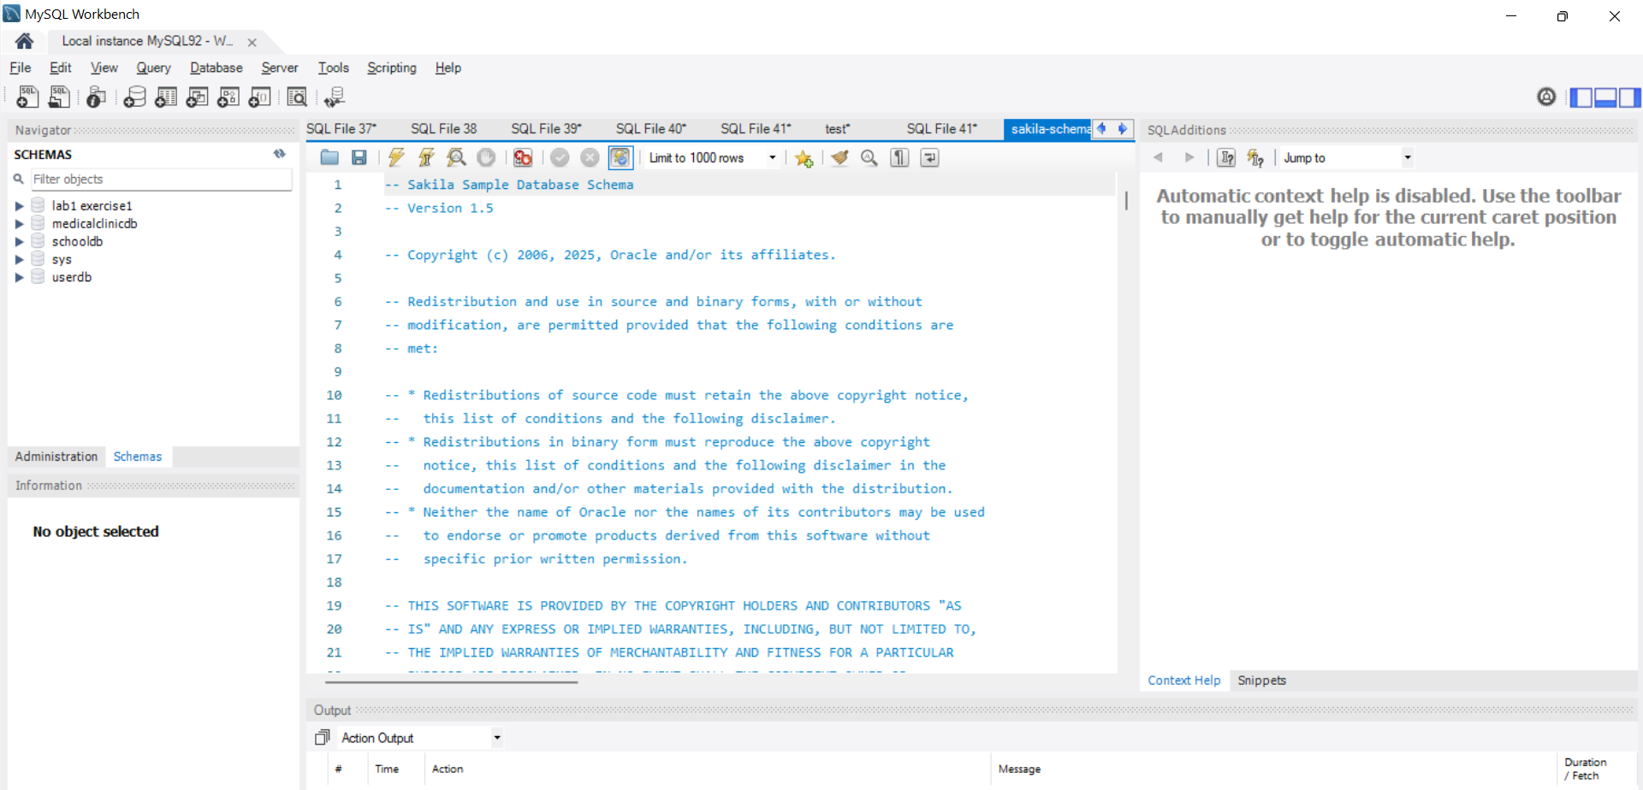
Navigate the SQL Script File
2 | Faculty of Business and Law | Peter Faber Business School

Slide 25
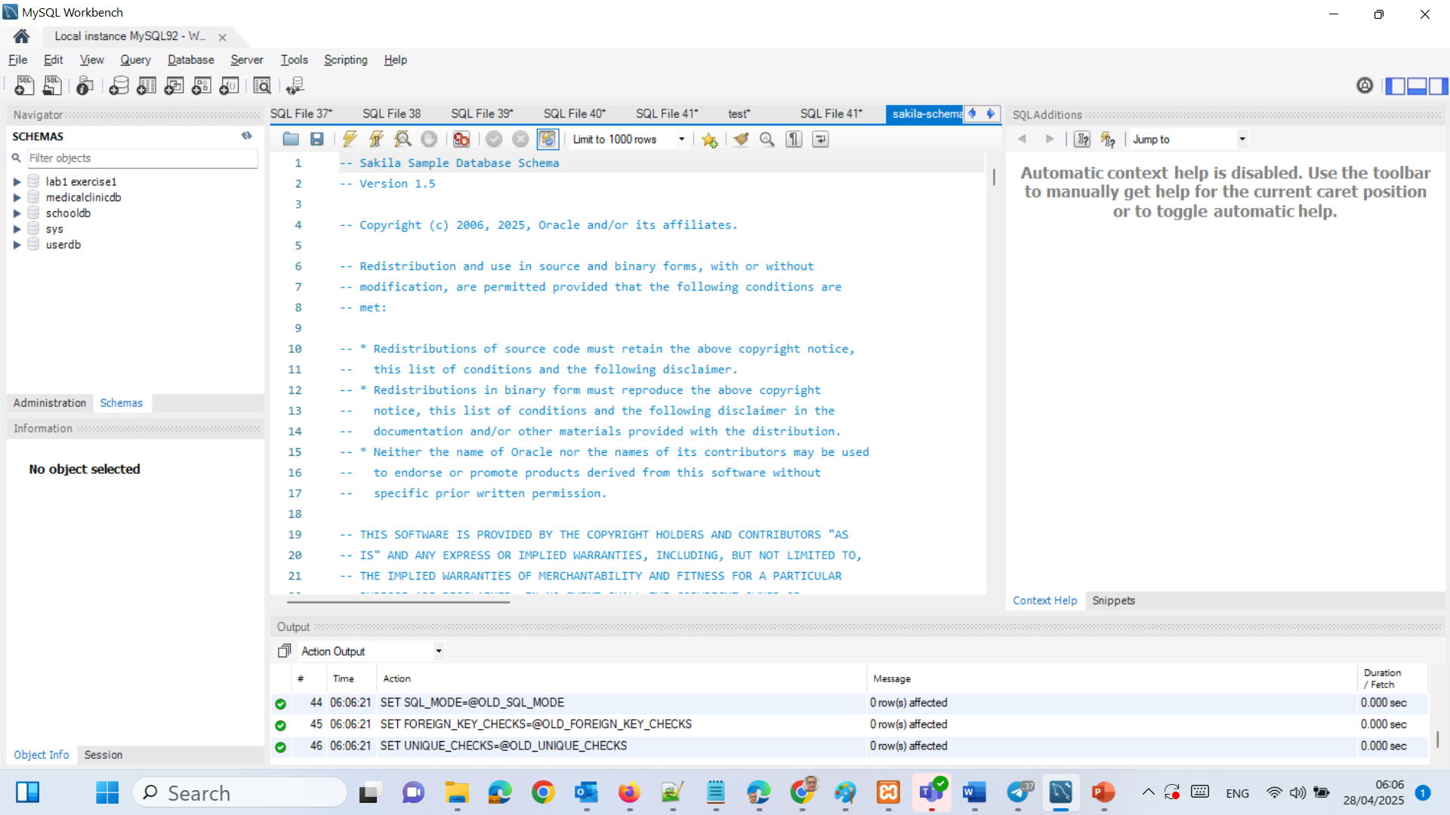
Navigate the SQL Script File
Run the Schema Script:
After opening the sakila-schema.sql file, click the Execute button (lightning bolt icon) to run the script. This will create the database schema in our MySQL instance.
2 | Faculty of Business and Law | Peter Faber Business School

Slide 26
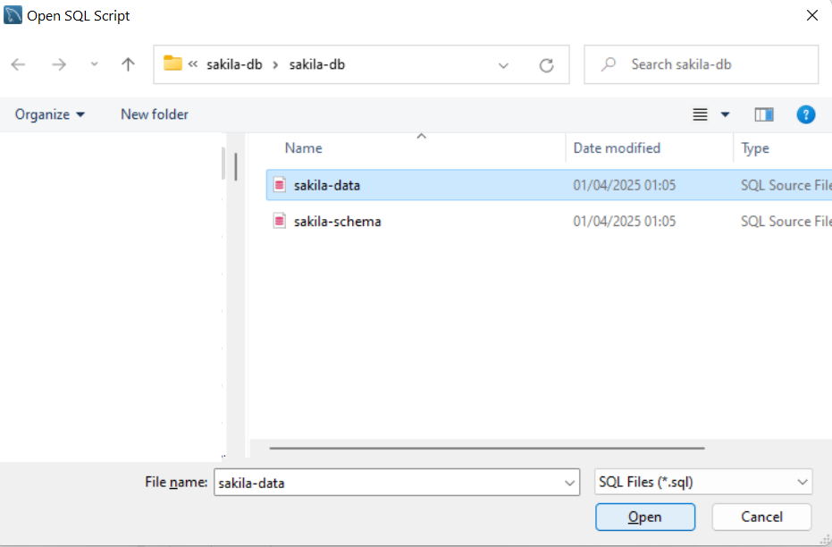
Run the Data Script
Run the Data Script:
Similarly, open the sakila-data.sql file and execute it to insert sample data into the database.
2 | Faculty of Business and Law | Peter Faber Business School

Slide 27
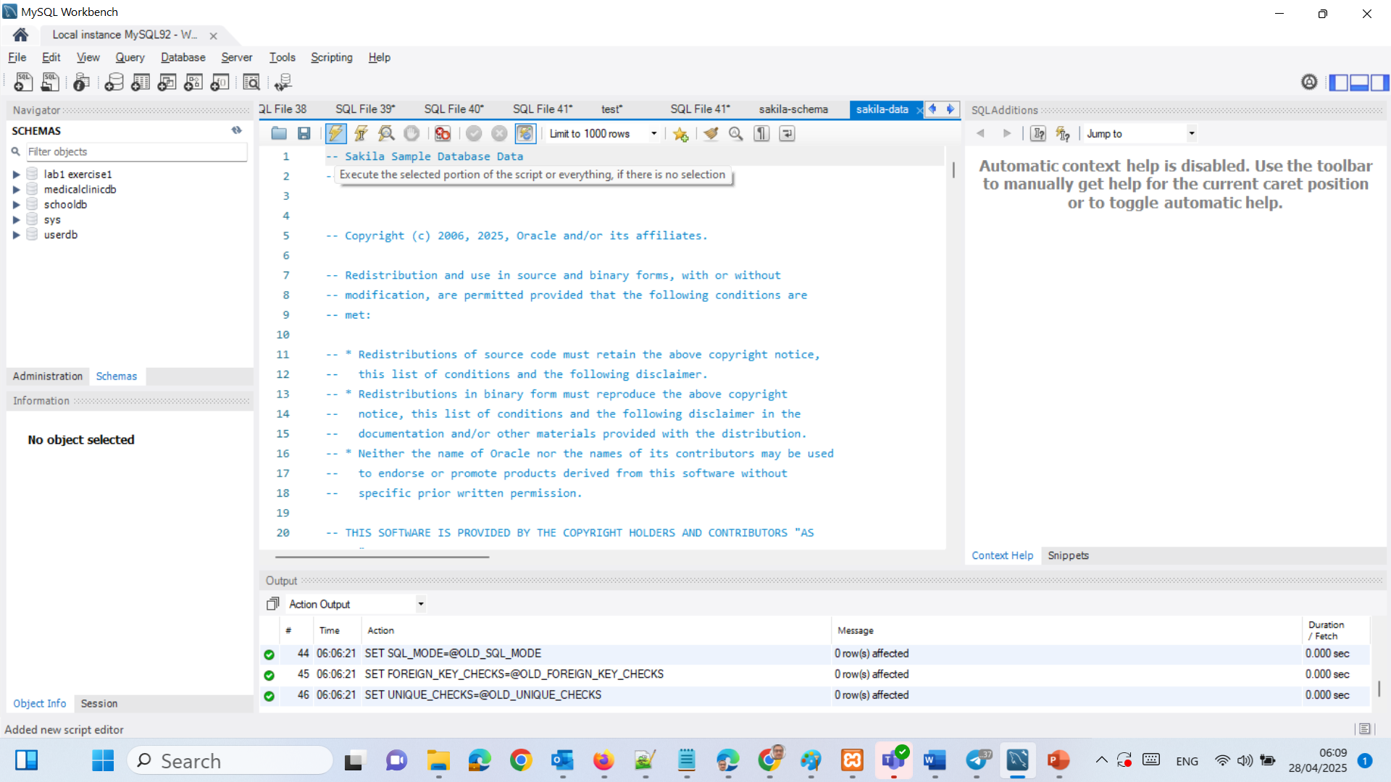
Run the Data Script
Run the Data Script:
Similarly, open the sakila-data.sql file and execute it to insert sample data into the database.
2 | Faculty of Business and Law | Peter Faber Business School

Slide 28
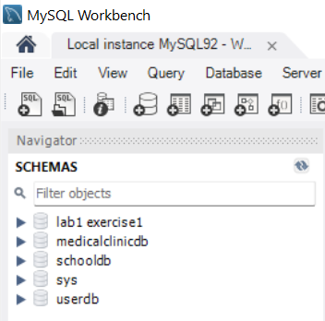
Sakila Database
Verify Installation:
Once both scripts are executed successfully, click on refresh, we should be able to see the Sakila database listed in the MySQL Workbench.
2 | Faculty of Business and Law | Peter Faber Business School

Slide 29
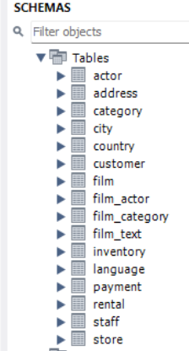
Description of Each Table in the Sakila Database
Table | One-Sentence Description
actor | Stores details of actors appearing in films.
address | Holds addresses for customers and staff.
category | Lists different genres or categories of films (e.g., Action, Comedy).
city | Contains the cities where addresses are located.
country | Lists countries corresponding to cities.
customer | Contains customer information for renting films.
film | Stores information about films available for rent.
film_actor | Links actors to the films they appear in (many-to-many relationship).
2 | Faculty of Business and Law | Peter Faber Business School

Slide 30
Description of Each Table in the Sakila Database
Table | One-Sentence Description
film_category | Links films to their categories (many-to-many relationship).
film_text | Provides a description of films for full-text search.
inventory | Tracks physical copies of films stored in different stores.
language | Lists available languages for films.
payment | Records payment transactions made by customers for rentals.
rental | Contains records of film rentals by customers.
staff | Contains employee (staff) information for the rental stores.
store | Represents physical rental store locations.
2 | Faculty of Business and Law | Peter Faber Business School

Slide 31
Quick Sakila Database Diagram
The diagram shows how customers, staff, and stores are connected through addresses and cities, while films are managed through inventory, categories, and actors. It highlights the relationships between renting, paying, and managing film copies across different store locations.
Country
City
Address
Customer
Staff
Rental
Payment
Store
Inventory
Film
Category
Actor
2 | Faculty of Business and Law | Peter Faber Business School

Slide 32
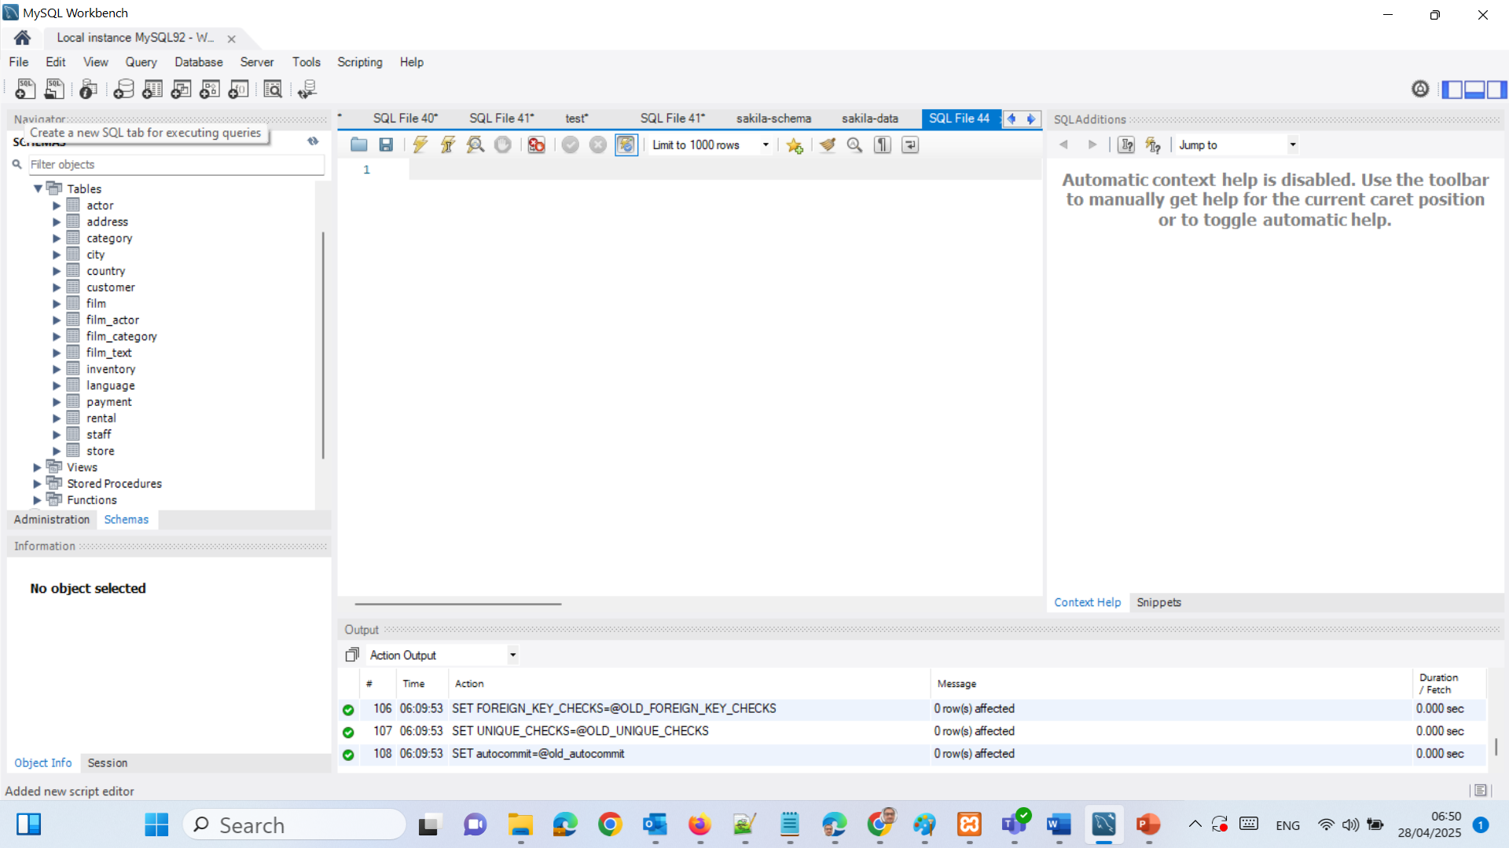
SQL JOIN Tasks
Task 1:
Write an SQL query to extract city_id, city name, and country name from Sakila database.
Step-by-Step:
The city table contains city_id, city, and country_id.
The country table contains country_id and country name.
We join city and country using country_id.
2 | Faculty of Business and Law | Peter Faber Business School

Slide 33
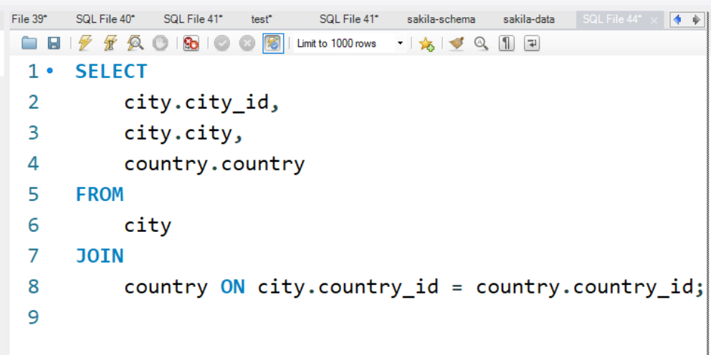
SQL JOIN Tasks
Join city and country on country_id.
Extract city_id, city name, and country name.
2 | Faculty of Business and Law | Peter Faber Business School

Slide 34
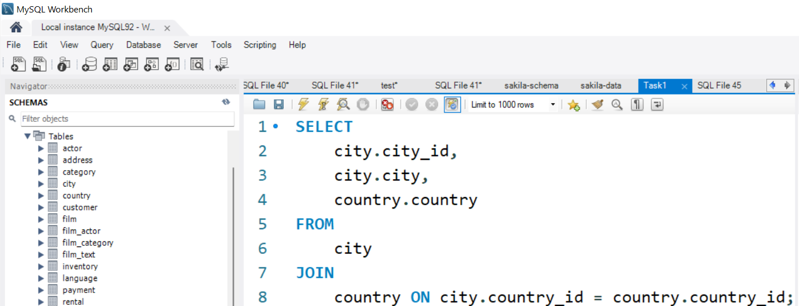
SQL JOIN Tasks
We can save it as Task 1.
2 | Faculty of Business and Law | Peter Faber Business School

Slide 35
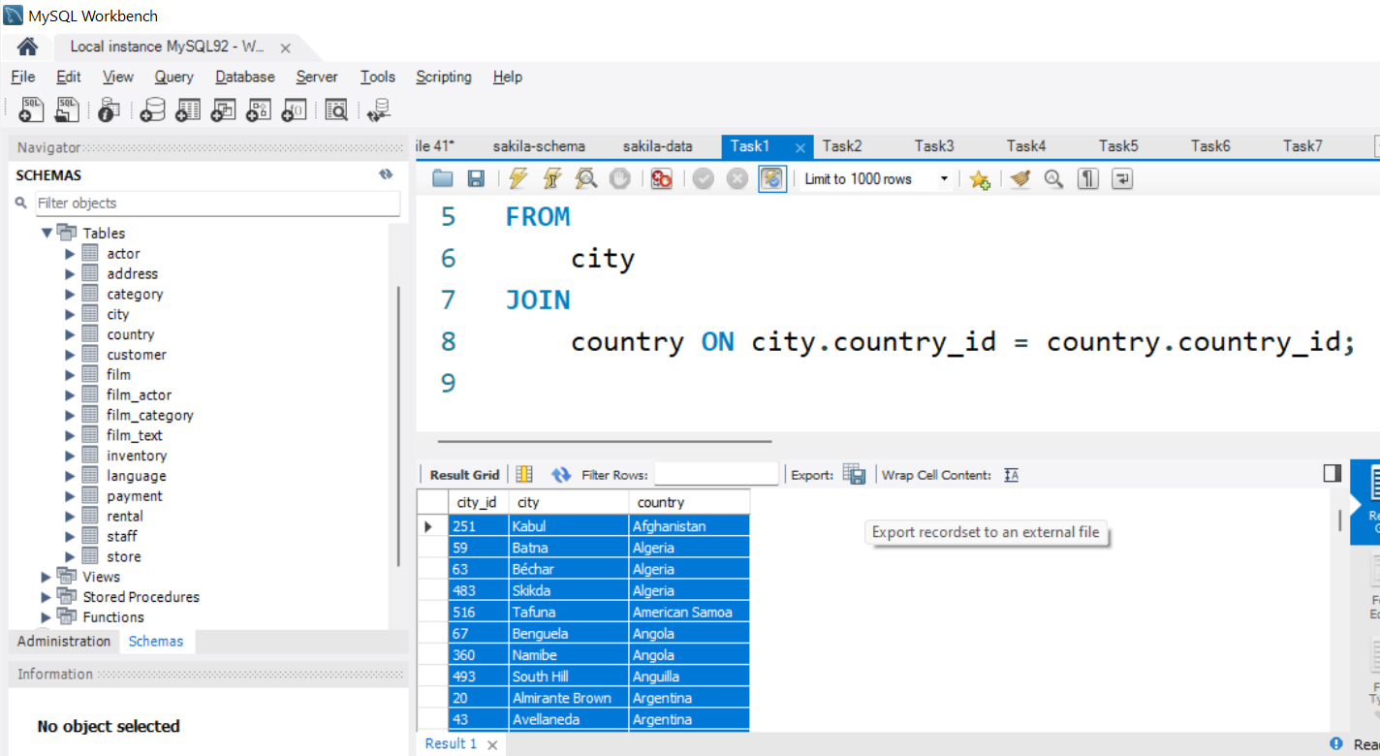
SQL JOIN Tasks
Execute. We can export the results as a csv file.
2 | Faculty of Business and Law | Peter Faber Business School

Slide 36
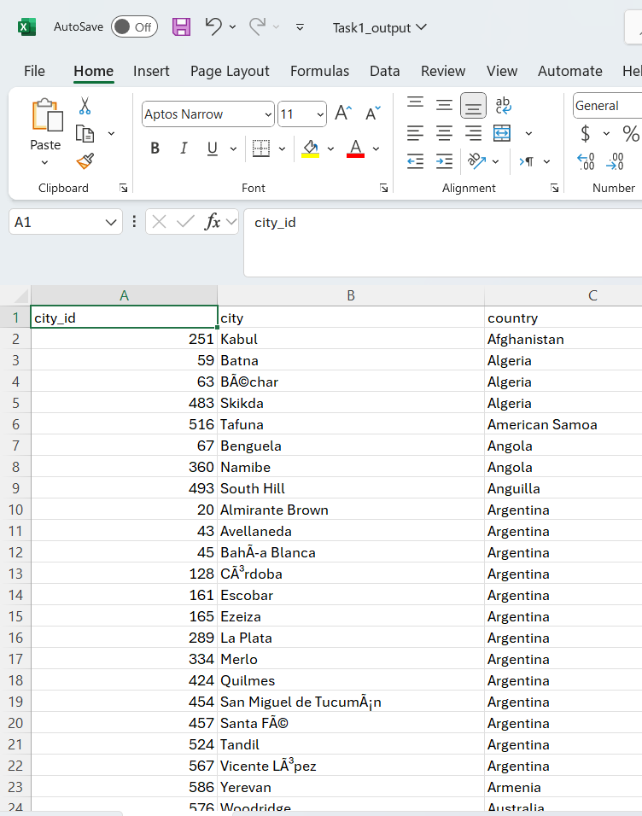
SQL JOIN Tasks
The query successfully lists each city alongside its corresponding country, confirming the relationship between cities and countries in the database. It shows that multiple cities can belong to the same country, highlighting the one-to-many relationship between the country and city tables.
2 | Faculty of Business and Law | Peter Faber Business School

Slide 37
Task 2:
Write an SQL query to return film title, year of release, and actor. Use LEFT JOIN for this task.
Step-by-Step:
film table contains film_id, title, and release_year.
film_actor links film_id and actor_id.
actor table has actor first_name and last_name.
Use LEFT JOIN so all films are shown, even if no actor is linked (hypothetical).
2 | Faculty of Business and Law | Peter Faber Business School

Slide 38
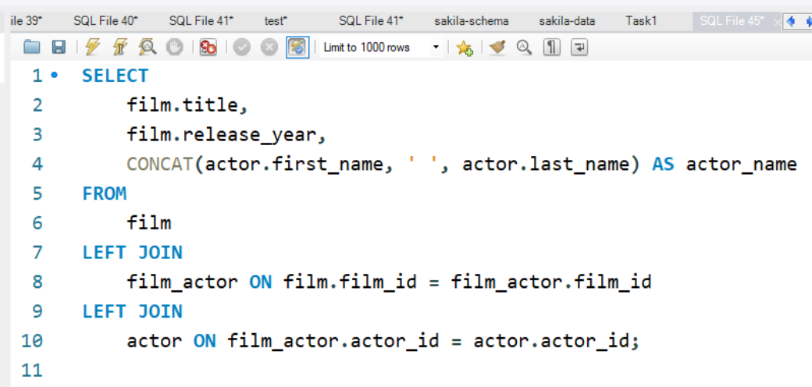
SQL JOIN Tasks
Left join film to film_actor, then film_actor to actor.
Combine actor's first and last names using CONCAT().
2 | Faculty of Business and Law | Peter Faber Business School

Slide 39
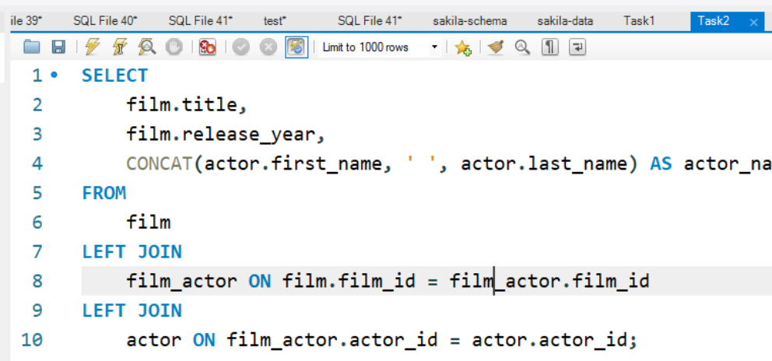
SQL JOIN Tasks
We can save it as Task 2.
2 | Faculty of Business and Law | Peter Faber Business School

Slide 40
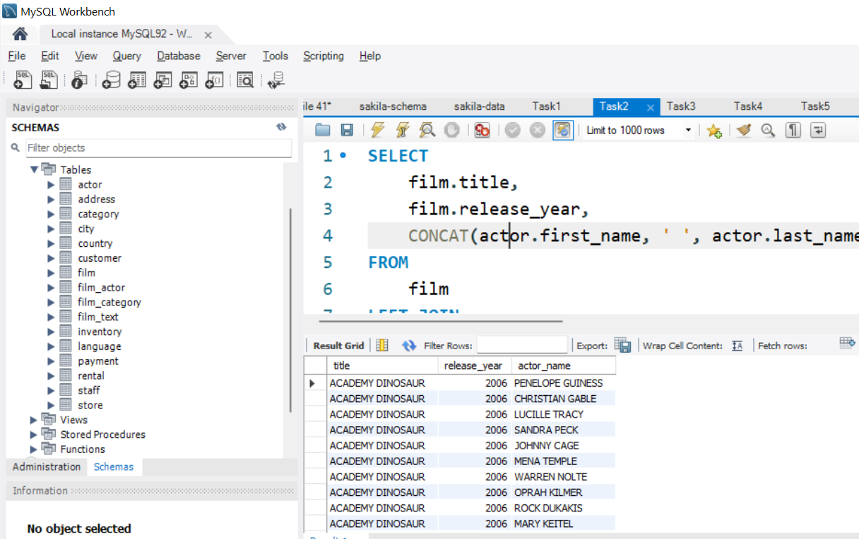
SQL JOIN Tasks
Execute it. We can export it as a csv file.
2 | Faculty of Business and Law | Peter Faber Business School

Slide 41
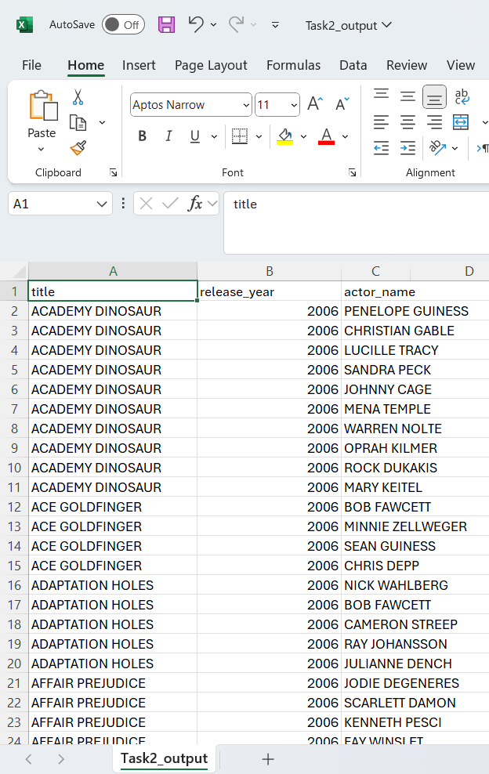
SQL JOIN Tasks
The results display a list of film titles and their release years along with actors associated with them. The LEFT JOIN ensures that all films are shown even if some films do not have actors linked, highlighting that the database accounts for possible missing actor-film relationships.
2 | Faculty of Business and Law | Peter Faber Business School

Slide 42
SQL JOIN Tasks
Task 3:
Select customer first name, last name, email, rental payment, staff, and payment amount using RIGHT JOIN.
Step-by-Step:
customer table: customer_id, first_name, last_name, email.
payment table: links customer_id, staff_id, amount.
staff table: contains staff_id, first_name, last_name.
2 | Faculty of Business and Law | Peter Faber Business School

Slide 43
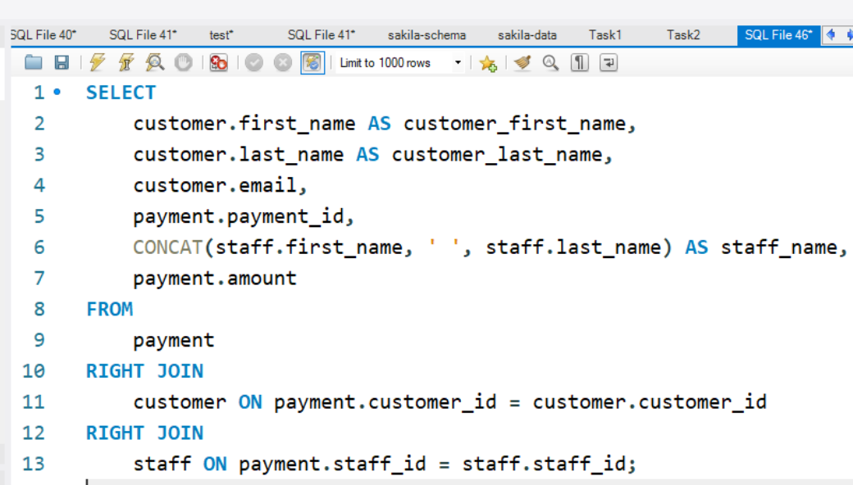
SQL JOIN Tasks
Right join ensures all customer and staff records are considered, even if payment is missing (hypothetically).
Retrieves customer's name, email, payment ID, staff name, and amount.
2 | Faculty of Business and Law | Peter Faber Business School

Slide 44
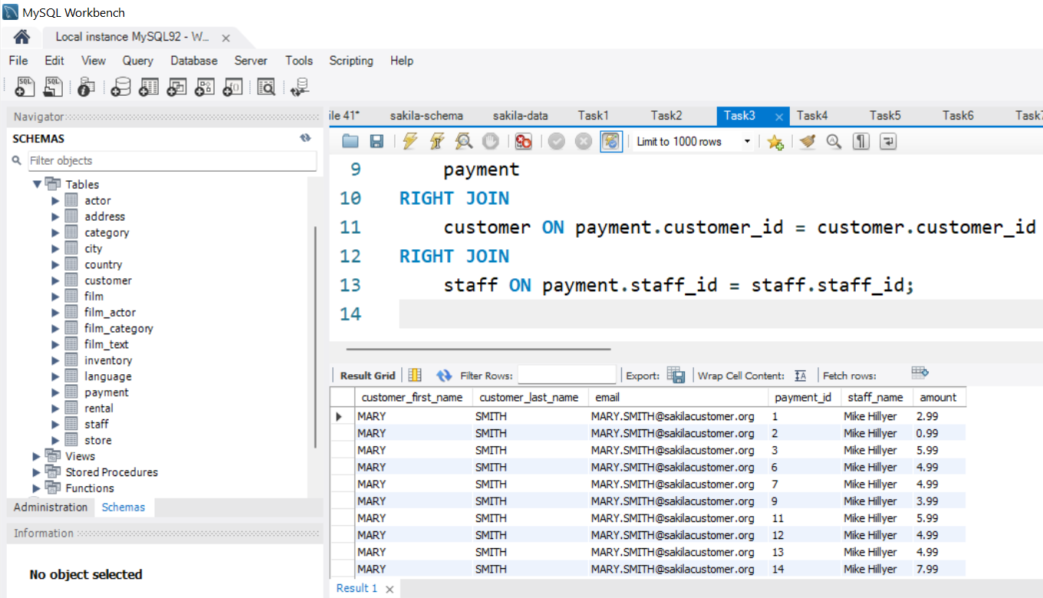
SQL JOIN Tasks
Execute it. We can export it as a csv file.
2 | Faculty of Business and Law | Peter Faber Business School

Slide 45
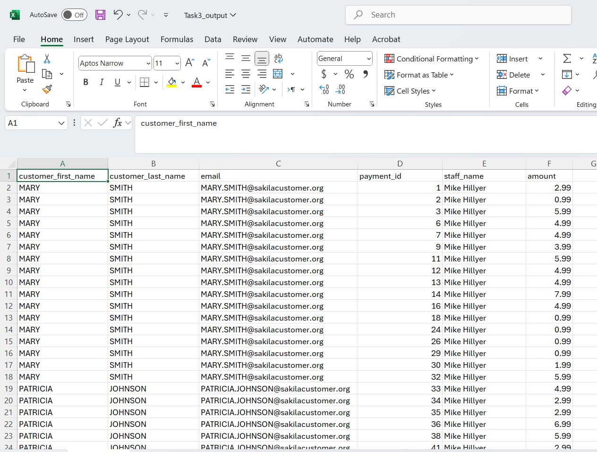
The query successfully connects customer details, payment information, and staff members handling the transactions. The use of RIGHT JOIN ensures that all staff and customer records are included, even if some have no associated payment records, which helps identify customers or staff with missing or pending transactions.
2 | Faculty of Business and Law | Peter Faber Business School

Slide 46
Quick Summary
Query | Tables Used | Type of JOIN | Focus
Task 1 | city, country | INNER JOIN (normal JOIN) | Match cities with their countries
Task 2 | film, film_actor, actor | LEFT JOIN | List all films even if missing actors
Task 3 | customer, payment, staff | RIGHT JOIN | List customers, payments, and staff
2 | Faculty of Business and Law | Peter Faber Business School

Slide 47
Bonus Tip
Always specify table names when fields have the same name in different tables (e.g., customer.first_name vs staff.first_name).
Always check if you need LEFT JOIN, RIGHT JOIN, or INNER JOIN depending on whether you want all records or only matching records.
2 | Faculty of Business and Law | Peter Faber Business School

Slide 48
SQL Aggregate Functions
Task 4:
How many films are associated with rating ‘PG’?
Step-by-Step:
We query the film table.
Use COUNT(*) to count the number of rows where rating = 'PG'.
2 | Faculty of Business and Law | Peter Faber Business School

Slide 49
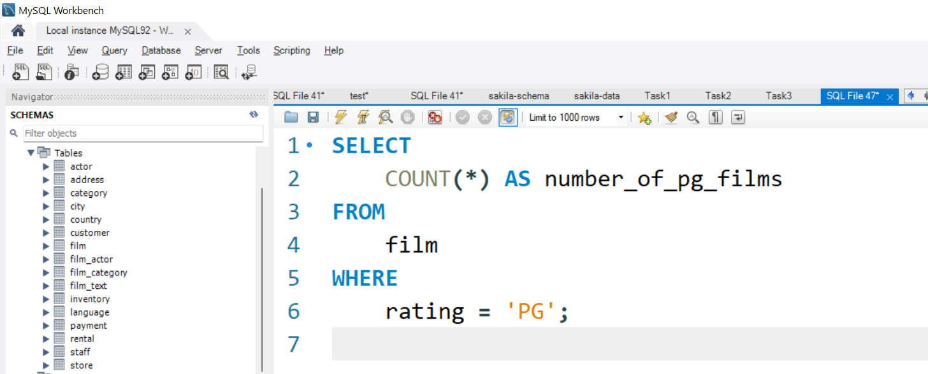
SQL Aggregate Functions
Counts all films that have a 'PG' rating
2 | Faculty of Business and Law | Peter Faber Business School

Slide 50
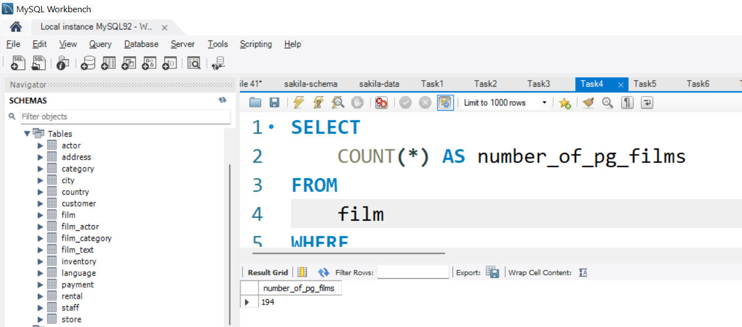
SQL Aggregate Functions
Execute it. We can export it as a csv file.
2 | Faculty of Business and Law | Peter Faber Business School

Slide 51
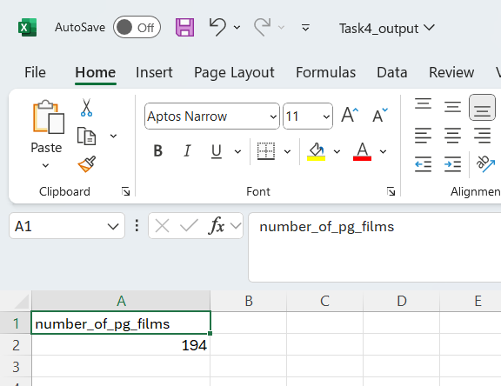
SQL Aggregate Functions
The result shows the total number of films rated 'PG' in the database. This provides a clear measure of how many family-friendly or parental-guidance films are available for rental in the Sakila film collection.
2 | Faculty of Business and Law | Peter Faber Business School

Slide 52
SQL Aggregate Functions
Task 5:
Write a query to return district, count of district as count_district for each district in address table.
Step-by-Step:
Use GROUP BY district to group all addresses by district.
Use COUNT(*) to count how many addresses in each district.
2 | Faculty of Business and Law | Peter Faber Business School

Slide 53
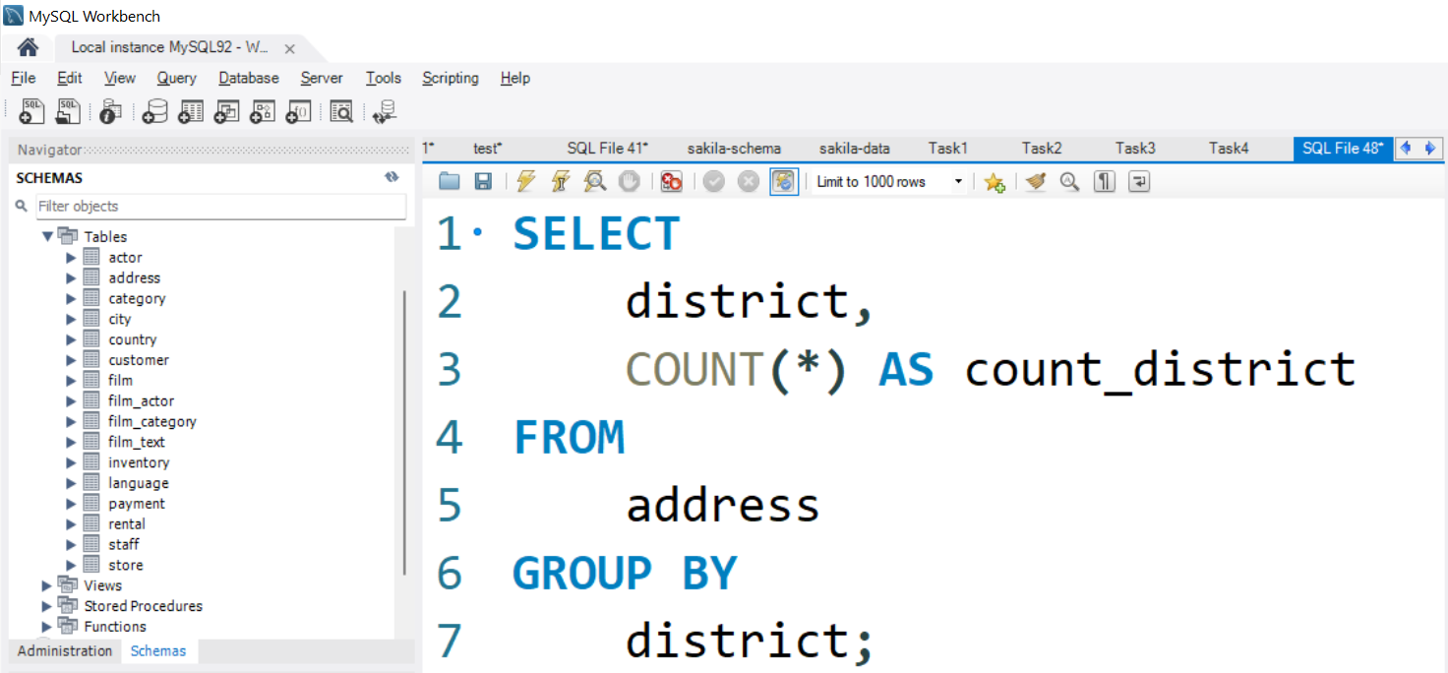
SQL Aggregate Functions
Groups records by each district and counts the number of addresses.
2 | Faculty of Business and Law | Peter Faber Business School

Slide 54
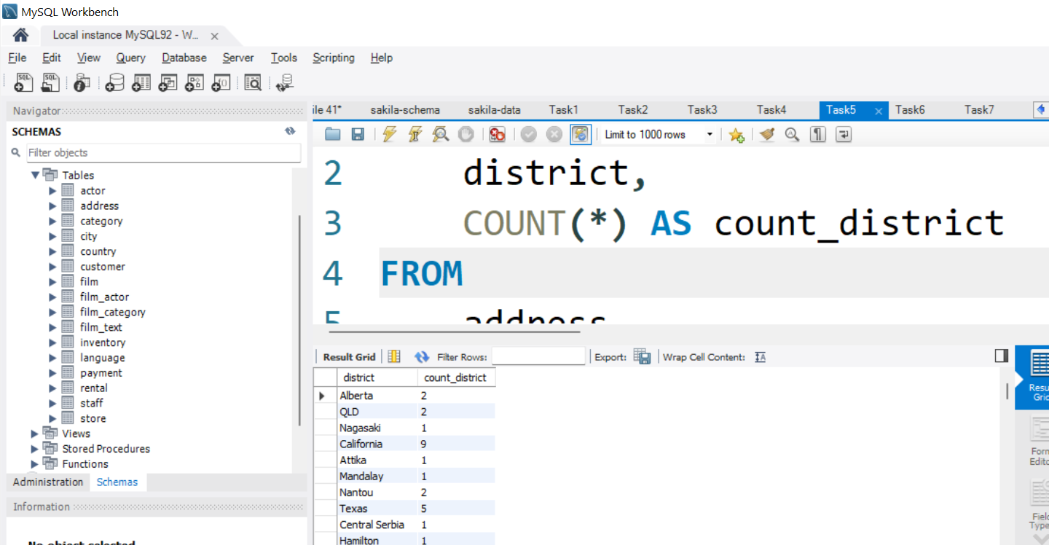
SQL Aggregate Functions
Execute it. We can export it as a csv file.
2 | Faculty of Business and Law | Peter Faber Business School

Slide 55
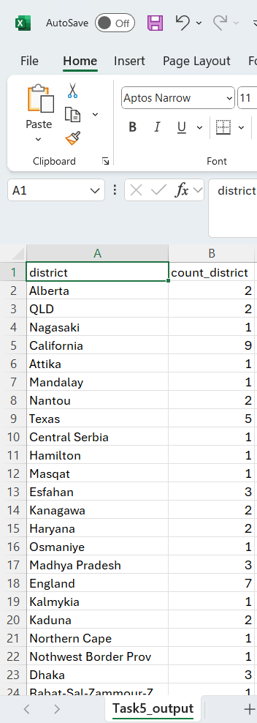
SQL Aggregate Functions
The results show the number of addresses registered in each district, helping to identify areas with higher or lower customer/staff density. Districts with a higher address count might represent major service regions, which can guide store planning or marketing efforts.
2 | Faculty of Business and Law | Peter Faber Business School

Slide 56
Task 6:
How would you select rating, minimum, maximum, and average values for rental rate for PG-13 rating from film table?
Step-by-Step:
Query film table.
Filter WHERE rating = 'PG-13'.
Use MIN(), MAX(), and AVG() aggregate functions on rental_rate
2 | Faculty of Business and Law | Peter Faber Business School

Slide 57
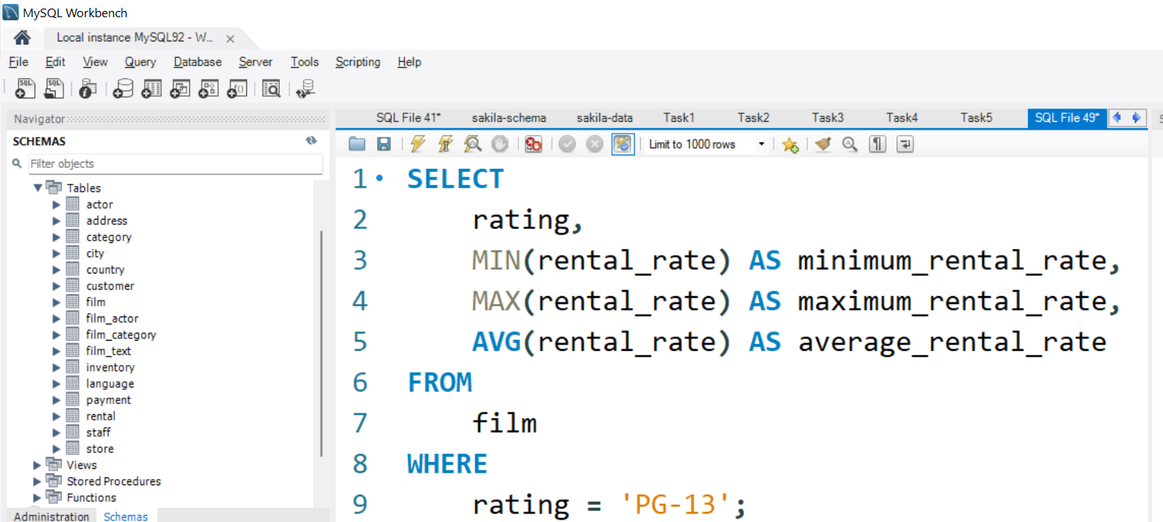
Filters only PG-13 films and calculates minimum, maximum, and average rental rates.
2 | Faculty of Business and Law | Peter Faber Business School

Slide 58
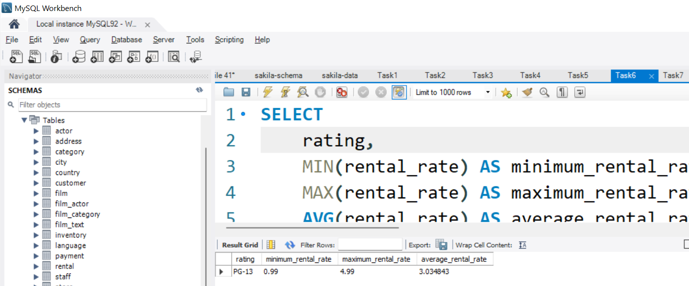
Execute it. We can export it as a csv file.
2 | Faculty of Business and Law | Peter Faber Business School

Slide 59
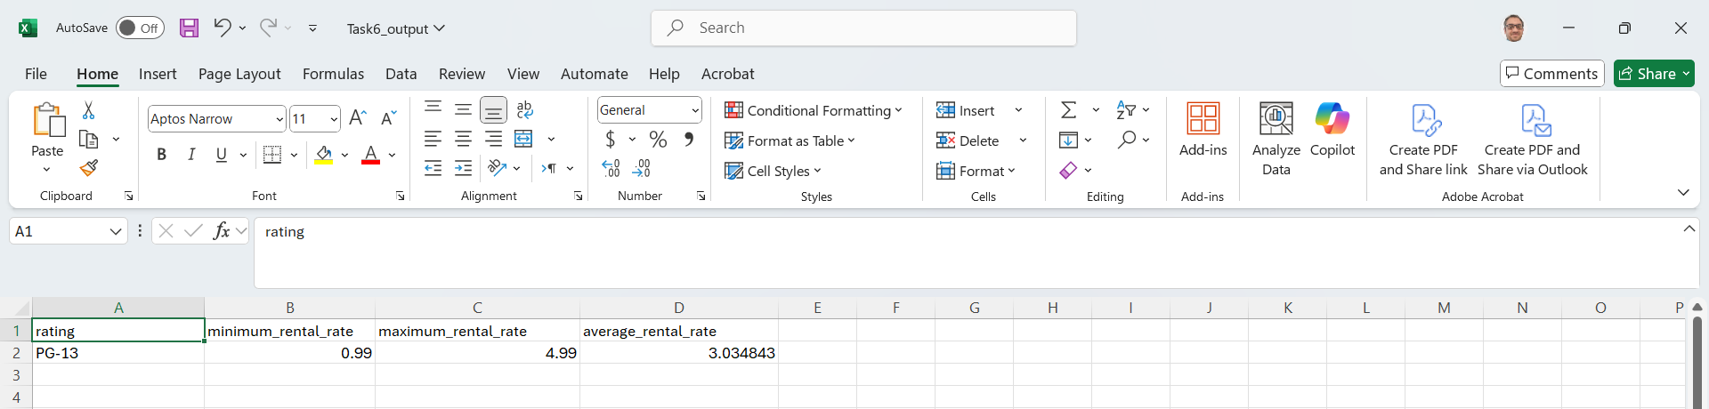
The query result highlights the distribution of addresses across different districts, showing which districts have higher customer or staff concentrations. This information is valuable for identifying target areas for business expansion, marketing, or operational focus.
2 | Faculty of Business and Law | Peter Faber Business School

Slide 60
Task 7:
How would you select rating, minimum, maximum, and average values for rental rate grouped by rating?
Step-by-Step:
Use GROUP BY rating instead of filtering one rating.
Calculate MIN(), MAX(), and AVG() rental rates for each group.
2 | Faculty of Business and Law | Peter Faber Business School

Slide 61
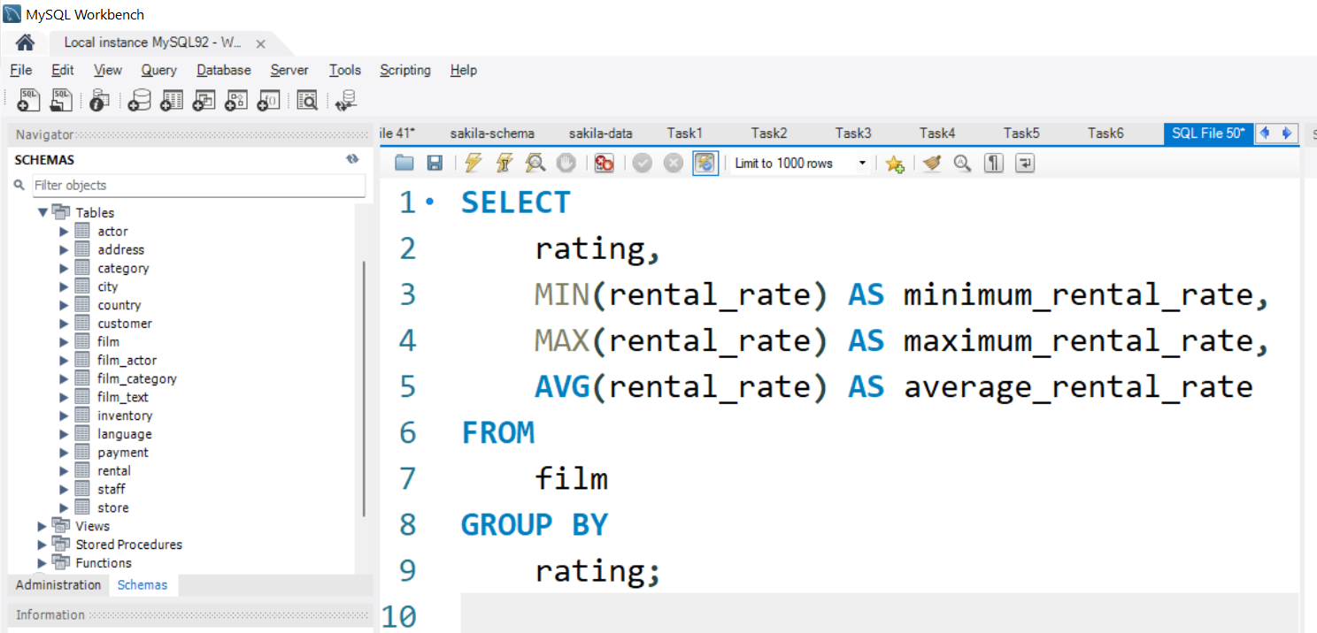
Groups films by rating and shows rental rate stats for each category (e.g., PG, PG-13, G, R).
2 | Faculty of Business and Law | Peter Faber Business School

Slide 62
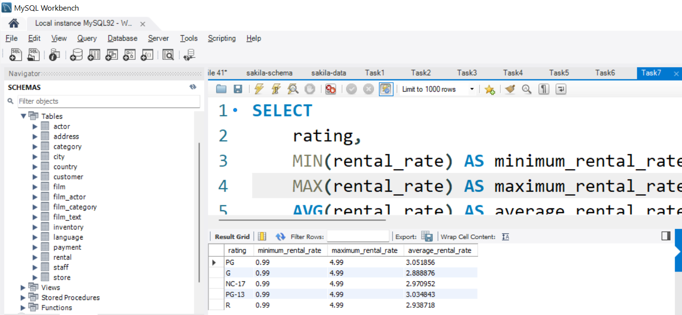
Execute it. We can export it as a csv file.
2 | Faculty of Business and Law | Peter Faber Business School

Slide 63
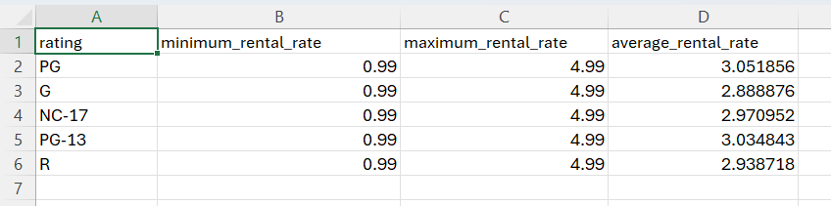
The query results show how rental rates vary across different film ratings, providing insights into pricing strategies for each rating category. Films rated 'R' or 'NC-17' might have slightly higher or lower rental averages compared to family-friendly ratings like 'G' or 'PG', revealing possible market value differences based on audience type.
2 | Faculty of Business and Law | Peter Faber Business School

Slide 64
Quick Learning Summary
Task | Main Focus | Function Used
Task 4 | Counting specific records (rating = 'PG') | COUNT(*)
Task 5 | Grouping and counting addresses by district | GROUP BY, COUNT(*)
Task 6 | Rental rate stats for PG-13 films only | MIN(), MAX(), AVG(), WHERE
Task 7 | Rental rate stats for all ratings | GROUP BY rating, MIN(), MAX(), AVG()
:
2 | Faculty of Business and Law | Peter Faber Business School

Slide 65
Quick Tip
Always use GROUP BY when you want aggregates (SUM, AVG, etc.) per category.
Always filter first (WHERE) before grouping if you want specific results only.
2 | Faculty of Business and Law | Peter Faber Business School

Slide 66
Conclusion
This guide has provided a step-by-step breakdown of the Practical Database Exercises for your Lab 4 – Week 8 (SQL Joins and SQL Aggregate Functions). Please complete the remaining parts. Make sure to follow each step carefully, document your work with SQL queries and screenshots, and submit the required Word document with your ER diagram and SQL code.
2 | Faculty of Business and Law | Peter Faber Business School

Slide 67
Submission of Labs & Assessments
These guidelines are designed to support your learning and help you apply necessary techniques effectively. For lab or assessment submissions, please follow instructions and complete tasks based on Canvas. If you have any questions, feel free to ask—I’m happy to help!

Slide 68
Thank You
Have a Great Learning Day!
Feel free to reach out with any questions!
Dr. Farshid Keivanian

